Slide 1
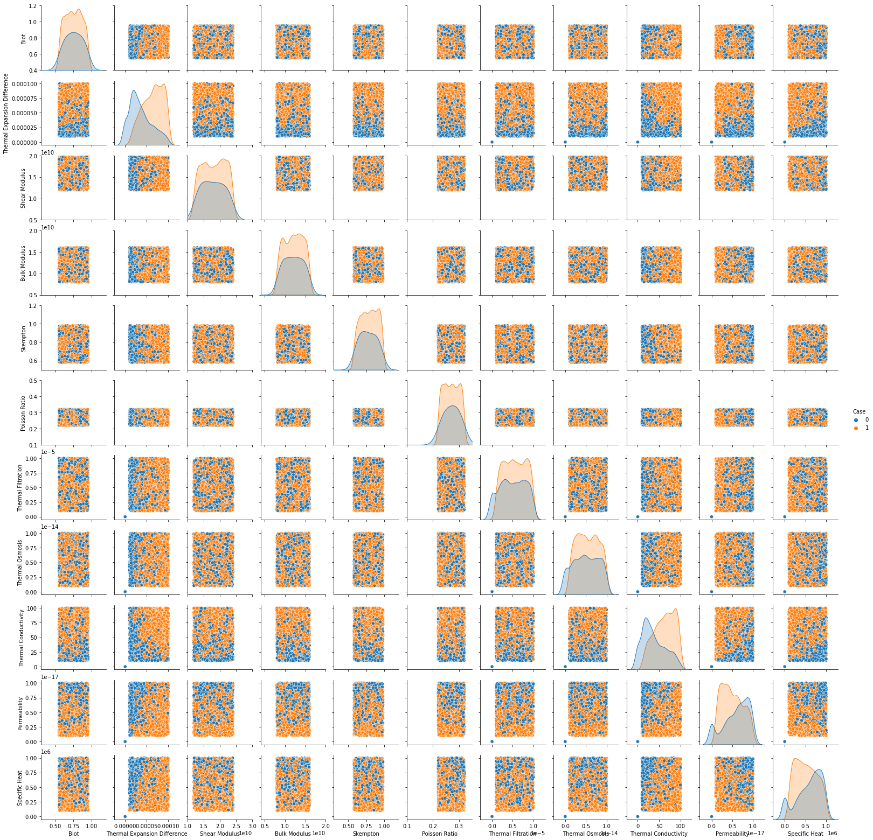

Slide 3
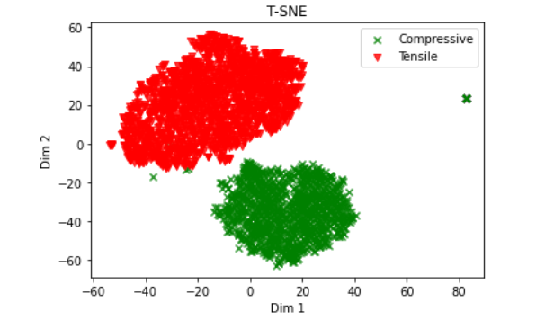
Non linear dimensionality reduction technique - t-distributed Stochastic Neighborhood Embedding (t-SNE)
Chrome-extension://efaidnbmnnnibpcajpcglclefindmkaj/https://economics.yale.edu/sites/default/files/files/Faculty/Tsyvinski/tSNE_draft15.pdf

